Slide 1
Living Smart @ Smart Home
¹Vishnu Sivan, ²Hema Dileep, ³Romariyo Johnson
P.G Scholar
Dept.Computer Applications
Mar Athanasius College of Engineering
Kothamangalam, India
⁴Shinu S Kurian
Assistant Professor
Dept.Computer Applications
Mar Athanasius College of Engineering
Kothamangalam, India

Slide 2
OUTLINE
Introduction
Objective
Literature review
Why Smart Home
Methodology and work description
Design steps
Conclusion
Reference

Slide 3
INTRODUCTON
Smart home - The various electrical and electronic appliances are controlled by a central computer control system.
Enhance the smart way of living by incorporating emotion recognition, Internet of things (IoT) and AI.
Remote access to the home appliances.
Smart homes devices are connected via standard means of communication for its operations.

Slide 4
INTRODUCTON (Contd.,)
Well-equipped system with energy saving concepts.
Make homes more smart by utilizing various sensors to control home appliances.
Smart homes work with fairly simple systems: receivers & transmitters.
Receivers detects a certain signal sends from the transmitter.
Intellectual decision making according to the environmental changes .

Slide 5
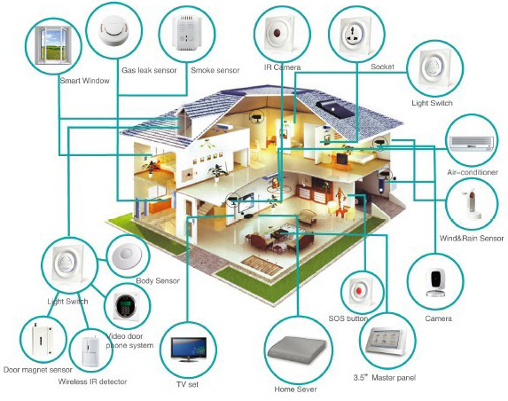

Slide 6
OBJECTIVES
Improve comfort
Ensure security
Enhance accessibility
Provide entertainment and convenience at all times
Provide a smart way of living

Slide 7
LITERATURE REVIEW
PAPER NAME AND AUTHOR | CONTRIBUTION | ADVANTAGES | LIMITATIONS
Next-generation insurance: tapping into the intelligence of smart homes, Agil Francis | Smart home architecture (Smart homes comprise three unique components: home appliances, home security devices and home infrastructure) | Remotely controlled appliances Interconnected devices | Privacy and security Interconnectivity and data standardization
Technology, systems and implementation of a smart home automation system: A review, Suraj Bhatia |  | Zigbee technologies Benefit for elderly or disabled persons living alone
Home automation using internet of things, Vinay Sagar | Cloud based system design | Integration of cloud networking Low cost design | Intellectual components are not included.

Slide 8
LITERATURE REVIEW (Contd.,)
PAPER NAME AND AUTHOR | CONTRIBUTION | ADVANTAGES | LIMITATIONS
Design and Implementation of an IoT Access Point for Smart Home, Chih-Yung Chang | The design and implementation of an IoT access point coordinating various wireless transmission protocols( Wi-Fi, ZigBee) | The original Wi-Fi AP can be upgraded to an IoT AP | Need more user interactions Less automated architecture
Artificial intelligence techniques for advanced smart home implementation, M. B. I. REAZ | Highlights research projects employing multi-agent system, action prediction, artificial neural network | Artificial Intelligence provide more efficient system | Less intelligence are provided. There is no feedback mechanism

Slide 9
WHY SMART HOME
Lifestyle personalization
Busy life in modern era
Security
Controlled motion sensors which allows for observation of activities
Ease of Control
Automated control of electric gadgets
SMART homes offers benefits for the disabled and elderly persons in the various ways
Monitory systems
Alert systems for the notifications

Slide 10
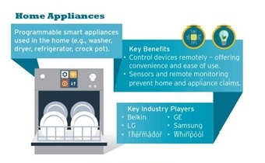
METHODOLOGY AND WORKING

Slide 11
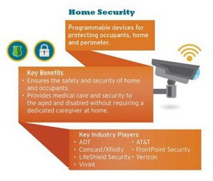

Slide 12
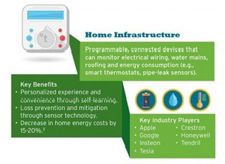

Slide 13
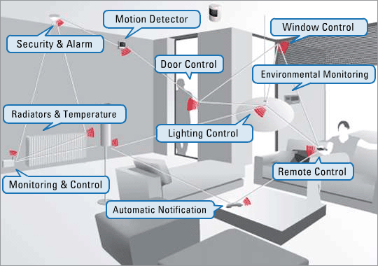
WORKING (Contd.,)

Slide 14
WORKING (Contd.,)
i. Controlled Devices:
The controlled devices (Air Conditioner, Light, Fan, Gate and Motor) are connected with a controller which is used to make the configuration of the device according to predictions and the previous stored results.
ii. Controller:
Controller is responsible to control the home appliances with improved level of access and enhanced prediction mechanism to take automatic configuration for the respective devices.
iii. I/O Interfaces:
The sensors are repeatedly tracking the user’s changes including their emotion as such.

Slide 15
WORKING (Contd.,)
Capture data on User Interaction
Accept by I/O interfaces
(Sensors)
Pass information to the controller
Is valid data ?
No
Refresh Controller State
Yes
A

Slide 16
A
Controller extract user changes,
Make necessary configuration as stated in prediction
User acceptance review and
Environmental changes
Accumulate the updated configuration, user behavior and situation

Slide 17
WORKING (Cont.,)
Behavior Table
Controller Id
User Behavior
State
Configuration
Controller Id | User Behavior | State | Configuration
1 (For Lights) | Sleeping | Bedroom | Set off
2 (For Fan) | Sleeping | Bedroom | Set on

Slide 18
SMART HOMES - FEATURES
Effectual Power Utilization
Eco friendly energy generation
Intellectual electrical appliances
Efficient interior and exterior lighting
Home Security System
Security cameras
Controlled access
Emergency

Slide 19
FEATURES(Contd.,)
Waste Management
Well-organized Biogas plants
Electrified decomposition of Non Biodegradable wastes
Fault Detection
Auto correct option
Ease of Access
Efficient appliances with more output and less input

Slide 20
CONCLUSION
Proposed system is more concentrated on user’s behavior
It has a prediction mechanism based on the user’s behavior and take necessary configuration to maintain the user happy
More secure : Responds to user changes only in the presence of authenticated person
Easier to access: The I/O interfaces continuously track the user’s changes and pass it to the controller for making appropriate changes
Reduce the power usage

Slide 21
REFERENCES
Agil Francis is a Principal/Director with Cognizant Business Consulting’s Insurance Practice, “Next-Generation Insurance: Tapping into the Intelligence of Smart Homes”
Vinay sagar K N1, Kusuma S M2, Student IV SEM, M.Tech, Digital Communication. Engg., MSRIT, Bangalore, India , “Home Automation Using Internet of Things”
Suraj Bhatia, Students, Department of Electronics and Telecommunication, Thadomal Shahani Engineering College, Bandra, Mumbai, “Technology, Systems and Implementation of a Smart Home Automation System: A Review”
Chih-Yung Chang, Department of Computer Science and Information Engineering, Tamkang University, No. 151, Yingzhuan Road, Tamsui District, New Taipei City 25137, Taiwan; “Design and Implementation of an IoT Access Point for Smart Home”
M. B. I. REAZ, department of electrical, electronic and systems engineering, universiti kebangsaan malaysia 43600, ukm, bangi, selangor, Malaysia, “Artificial intelligence techniques for advanced smart home implementation ”

Slide 22
REFERENCES (Cont.)
Dhiren Tejani, Ali Mohammed A. H. Al-Kuwari, Energy Conservation in Smart Home, 5th IEEE InternationalConference on Digital Ecosystems and Technologies,Daejeon, Korea, May 2011
Jaszczyk P, Król D (2010). Updatable multiagent OSGi architecture for smart home system. Agent and Multi-Agent Systems: Technologies and Applications. 6071: 370-379.
U.A. Bakshi, V.U. Bakshi, “Principles of Control Systems”, chapter 1, page 1-2, Technical Publications.
Press Release: “Smart Home Revenues to reach $71 billion by 2018, Juniper Research Finds,” Juniper Research, February, 2014
“SAMSUNG to Acquire SmartThings, Leading Open Platform for the Internet of Things,” samsung.com, August, 2014.
http://www. samsung.com/us/news/23607

Slide 23
REFERENCES (Cont.)
“SAMSUNG to Acquire SmartThings, Leading Open Platform for the Internet of Things,” samsung.com, August, 2014. http://www. samsung.com/us/news/23607/.
“Google Unveils Brillo, Its Answer for Smartifying Your Home,” wired.com, May, 2015. http://www.wired.com/2015/05/googleunveils-brillo- answer-smartifying-home/.
Al-Ali, Member, IEEE & M. AL-Rousan,“Java-Based Home Automation System R.” IEEE Transactions on Consumer Electronics, Vol. 50, No. 2, MAY 2004
“Vision of Smart Home: The Role of Mobile in the Home of the Future,” GSMA, March, 2010

